Slide 1
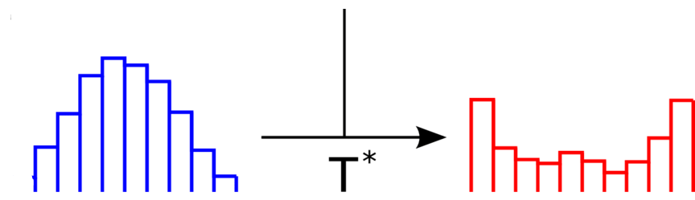
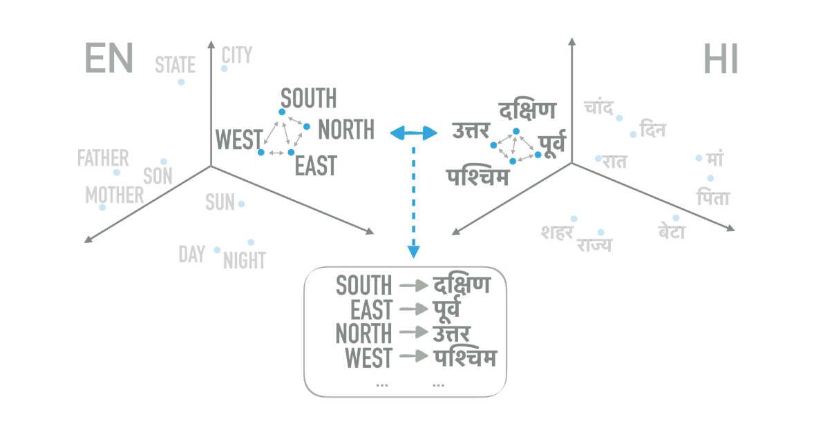
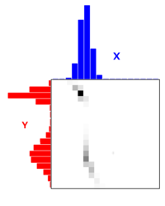
Structured Optimal Transport
~ Presented by
M S Nishanth
CS18MTECH11005

Slide 2
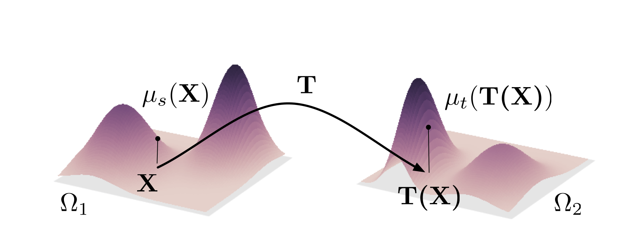

Slide 3
Optimal Transport Problem
Given the transportation of one unit of the commodity from Pi to Mj costs cij . How to transport the required quantity of the commodity at the lowest cost?
Optimal transport provides a natural, elegant framework for comparing probability distributions while respecting the underlying geometry [1]
[1]: https://optimaltransport.github.io/book/

Slide 4


Slide 5
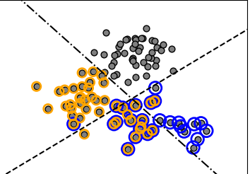

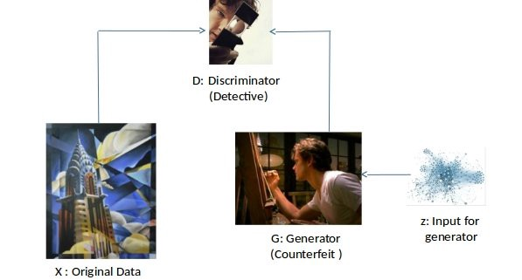
Multi-label classification
Adversarial Neural Network
Domain Adaption
Image analysis
** All images from Google

Slide 6
Structured Optimal Transport
To capture the structure of the settings.
Intrinsic: if the distributions correspond to structured objects (e.g., images with segments, or sequences)
Extrinsic: if there is side information that induces structure (e.g. groupings).
example: Domain Adaptation.

Slide 7
Goal
To incorporate structural information directly into the optimal transport problem.

Slide 8
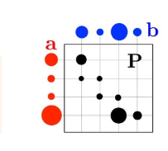
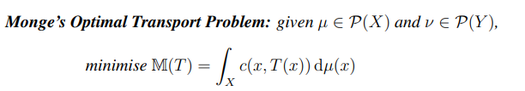
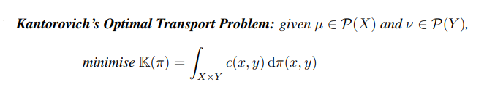

Formulation of Optimal Transport
** Introduction to Optimal Transport Matthew Thorpe
Img source: Google

Slide 9
Img source: Google

Slide 10

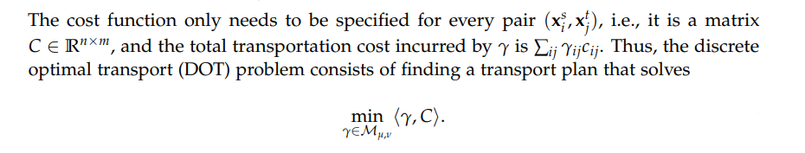
Img source: Google
** https://optimaltransport.github.io/book/

Slide 11
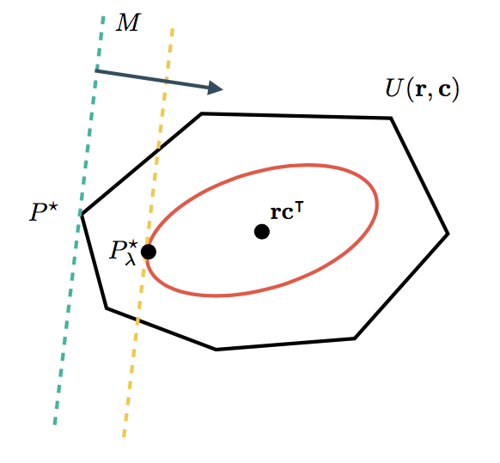

Entropic Regularization
A matrix with low entropy will be sparser, Conversely, a matrix with high entropy will be smoother [with the maximum entropy achieved with a uniform distribution of values across its elements].
With a regularization coefficient, we can include this in the
optimal transport problem to encourage smoother
coupling matrices.
Img source: https://michielstock.github.io/OptimalTransport/

Slide 12
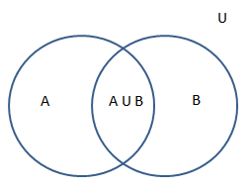
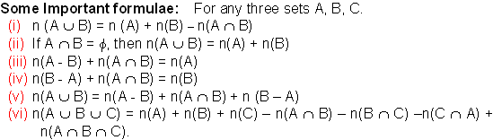
Modular function

Slide 13


Submodularity

Slide 14
Why Submodularity?
It allows us to encode various types of structural information in the cost function.

Slide 15
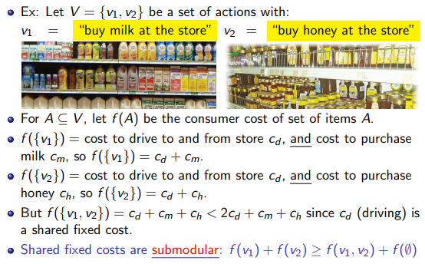

Slide 16
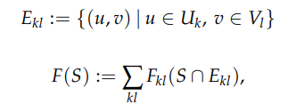
How?
We try a matching of variables in U (source) and V (target) with minimal cost. Here any matching can be expressed as a set of edges S = {(u1, v1), . . . ,(uk , vk)}, and its cost as a set function F : 2|U|×|V| → R+.
We divide the support of the source and target distributions µ and ν into regions Uk ⊂ U and Vl ⊂ V.
And calculate the cost as:
Here, each Fkl is a Submodular function
Formula: Structured Optimal Transport David Alvarez-Melis, Tommi S. Jaakkola, Stefanie Jegelka

Slide 17
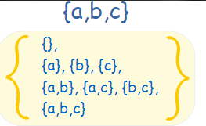
Computation time for this?

Slide 18
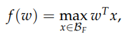
Lovasz Extension and Submodularity
If F is submodular, the Lovasz extension is equivalent to the support function.
And this is convex. In Fact a conic.
** https://optimaltransport.github.io/book/

Slide 19

Previously, our optimization function was
We know that this is a convex function we can apply lovasz extension and get,
Converted to

Slide 20
Mirror Descent Algorithm
The algorithm has 2 steps. Which is iterated to get an optimal solution.
Calculate gradient for lovasz extension.
Sinkhorn projection of the Gradient.

Slide 21
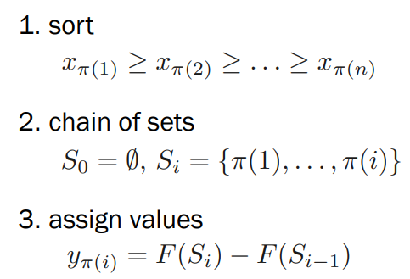
Calculating gradient for lovasz extension.

Slide 22
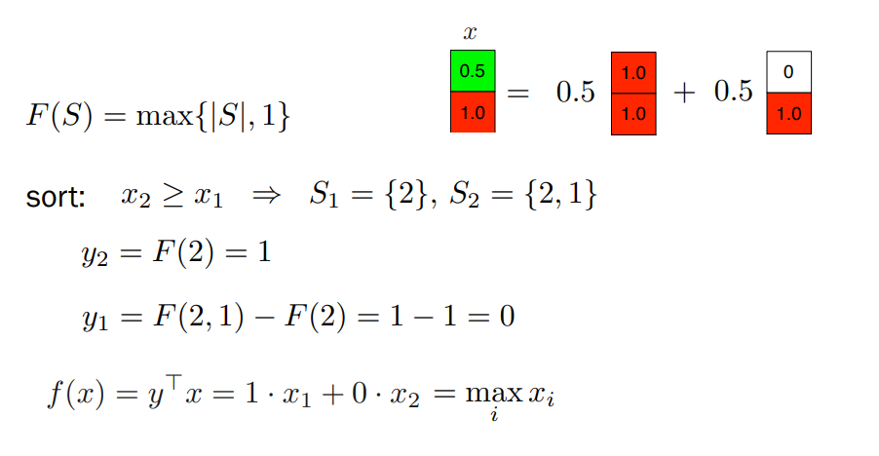
** Submodular Functions – Part II ML Summer School Cádiz

Slide 23
Sinkhorn projection
The solution is easily derivable.
Solution by adding Lagrange’s multipliers and solving.

Slide 24
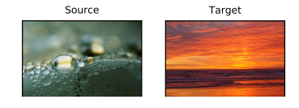
Results from paper

Slide 25
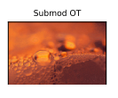

Slide 26
Shortcomings of paper
- The original OT is a linear program, whereas the structured OT is NOT.
- The claim is that we can introduce structure and handle the same applications as SOT without changing the form of the OT to a non-linear program

Slide 27
Our method
We propose to change the cost function to that of an induced norm from the paper.
structured sparsity-inducing norms through submodular functions.
** Structured sparsity-inducing norms through submodular functions Francis Bach

Slide 28
references
Cuturi, Marco. "Sinkhorn distances: Lightspeed computation of optimal transport." Advances in neural information processing systems. 2013.
Alvarez-Melis, David, Tommi S. Jaakkola, and Stefanie Jegelka. "Structured optimal transport." arXiv preprint arXiv:1712.06199 (2017).
Bach, Francis R. "Structured sparsity-inducing norms through submodular functions." Advances in Neural Information Processing Systems. 2010.
Some online materials:
https://www.youtube.com/watch?v=ZZT3bQ8BgV4
https://www.youtube.com/watch?v=sMWQkl0p6XM
https://dfdazac.github.io/sinkhorn.html
https://michielstock.github.io/OptimalTransport/
https: //github.com/rflamary/POT
Submodular Functions – Part II ML Summer School Cádiz Stefanie Jegelka

Slide 29
Thank you

Slide 30
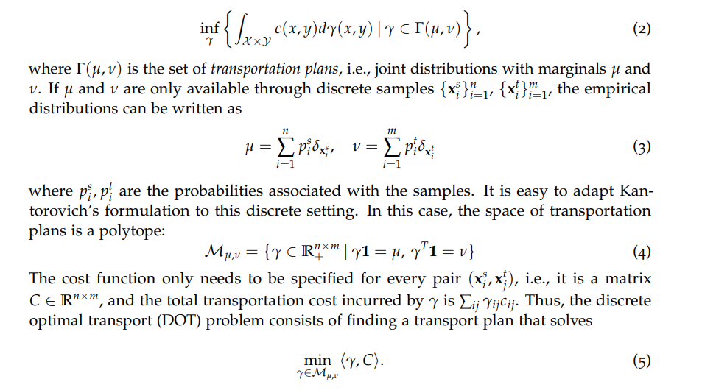

Slide 31
Applications of optimal transport distances: Shape analysis [Gangbo and McCann, 2000], image registration and interpolation [Solomon et al., 2015], domain adaptation [Courty et al., 2017], adversarial neural networks [Arjovsky et al., 2017], and multi-label prediction [Frogner et al., 2015]... etc

